Slide 1


DMS Project 2021
Lukasz Dudek

Slide 2
Consultant Journey
Agile – Scrum, Kanban (Jira)
Source Control – Git, GitHub
Cloud – GCP
Database – MySQL
Front-End Languages – HTML, CSS, JavaScript
Backend Language – Java
API Framework – Sprint
Build Tool – Maven
Testing – Junit, Mockito
User Acceptance Testing – Selenium

Slide 3
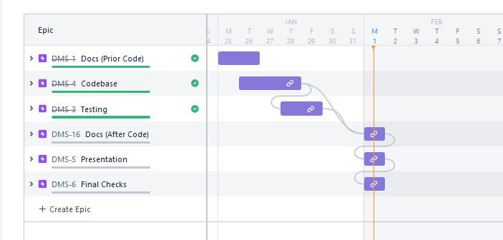
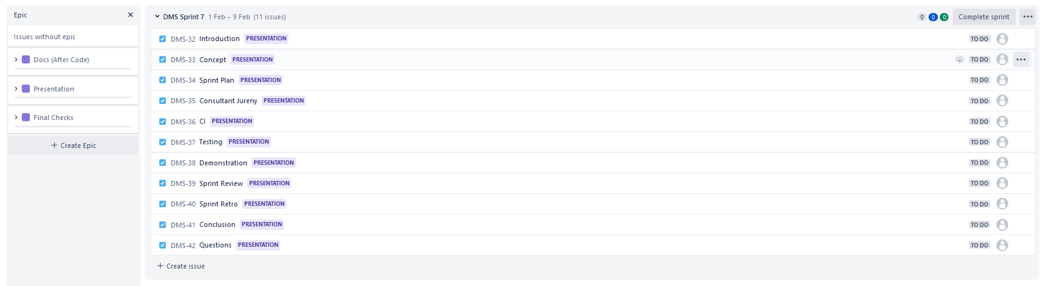
Kanban Board (Jira)
Used Jira to manage Project timeline
Split up work into small tasks

Slide 4
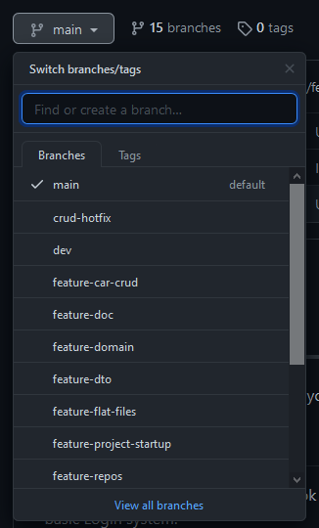
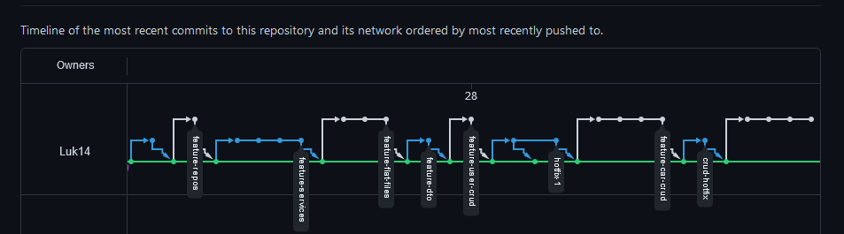
Source Control
Used a Feature Branch Approach
Kept comments clean and linked to Jira

Slide 5
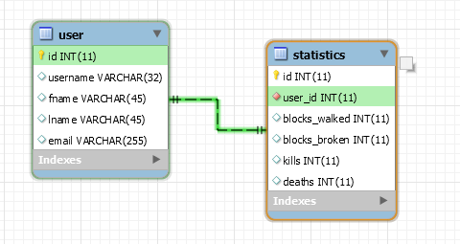
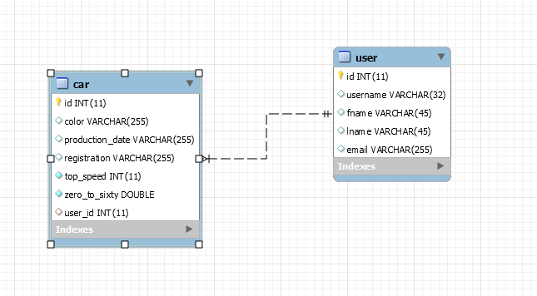
Database
We have used MySQL for this Project
With 2 tables with a 1 to many relationship

Slide 6
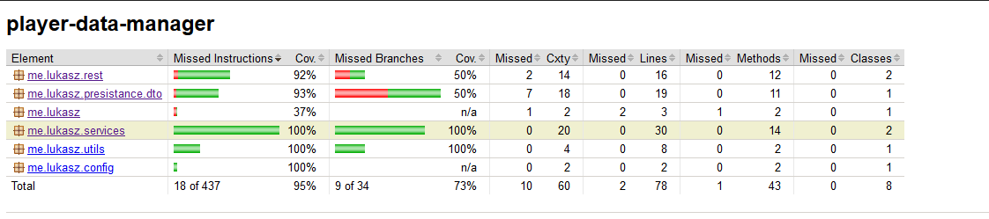
Testing
Used Junit and Mockito for testing the Project
Objective was to meet an industry standard of 80%+

Slide 7
Demo Time!

Slide 8
Sprint Review
What went well?
Testing was above the Standard
Full MvP was met
Jira and GitHub integration
What did not go well?
Time estimations on Jira, could have been planned better

Slide 9
Sprint Retrospective
How could I improve next time!
Estimations should have been further evaluated, before putting down a time
Try to comment more of the JS/HTML Code to ensure a clear understanding

Slide 10
Any Questions?

